Slide 1

Animal Rescue Databook
Rathnapriya gopalakrishnan

Slide 2
NARRATIVE
Animal Rescue Organizations are groups which take in abandoned pets and care for them until a suitable home can be found for the animals.
This database is created to assist the rescue organization in collecting, storing, maintaining and querying information relating to animal rescue process.

Slide 3
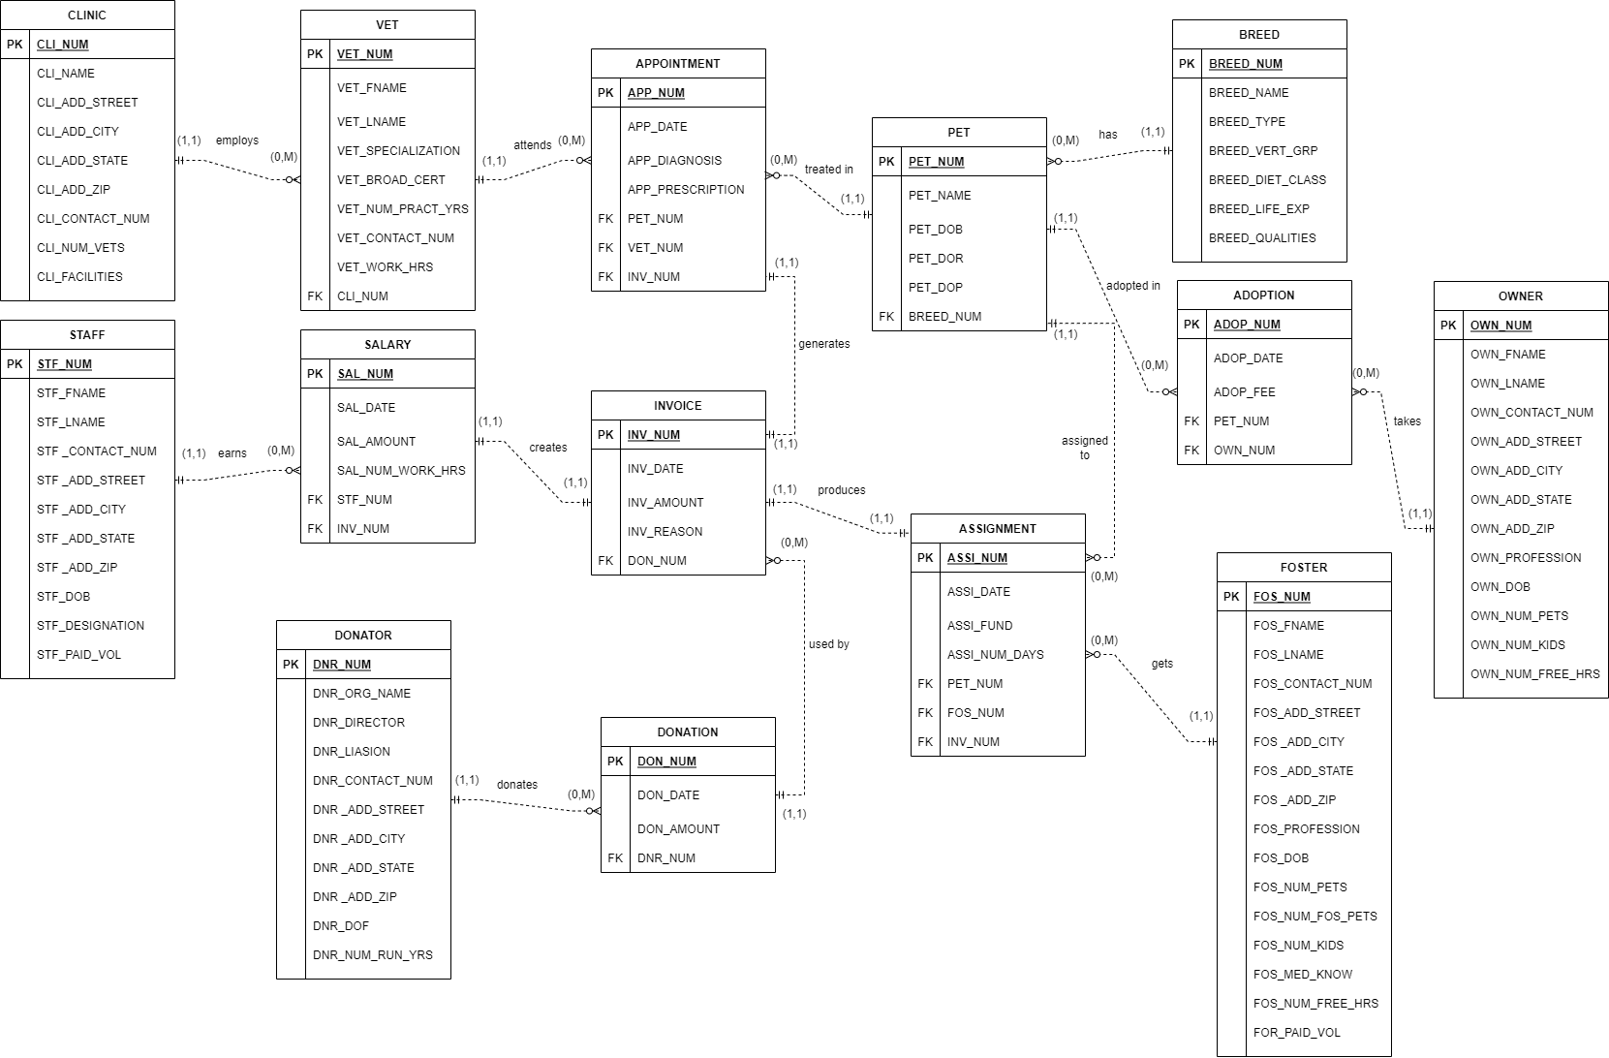
TABLES
ERD
PET
BREED
VET
CLINIC
APPOINTMENT
OWNER
FOSTER
STAFF
ADOPTION
ASSIGNMENT
DONATOR
DONATION
INVOICE
SALARY

Slide 5
Entity Relationship Model (ERM) Components:
ENTITY | RELATIONSHIP | CONNECTIVITY | ENTITY
BREED | has | 1:M | PET
OWNER | adopts | M:N | PET
FOSTER | raises | M:N | PET
CLINIC | employs | 1:M | VET
VET | treats | M:N | PET
DONATOR | donates | 1:M | DONATION
DONATION | used by | 1:M | INVOICE
APPOINTMENT | generates | 1:1 | INVOICE
ASSIGNMENT | produces | 1:1 | INVOICE
SALARY | creates | 1:1 | INVOICE
STAFF | earns | 1:M | SALARY

Slide 6
Datatypes
CHAR – PET_NUM, BREED_NUM,ADOP_NUM
VARCHAR – VET_FNAME, CLI_ADD_STREET, OWN_PROFESSION
DATE – PET_DOB, PET_DOR, INV_DATE, ADOP_DATE
INT – VET_NUM_PRACT_YRS, OWN_NUM_PETS,
NUMERIC – DON_AMOUNT, ASSI_FUND, SAL_AMOUNT

Slide 7
USERS
Rescue Staffs:
Access to all Tables
Enter, edit and query information
General public:
access to the pet details, their breed information, and their medical history.
informed decision in the adoption process
Donating Organizations:
Fund Allocation Reports
Tracking Funds and hindering fund mismanagements

Slide 8


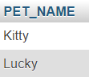
SQL Queries:
How many numbers of pets are rescued in the year 2021 by the animal rescue?
SELECT COUNT(*) AS 'Number of pets rescued in 2021'
FROM PET
WHERE YEAR(PET_DOR) = 2021;
What are the names of Golden Retriever dogs rescued by the animal rescue?
SELECT PET_NAME
FROM PET INNER JOIN BREED
ON PET.BREED_NUM = BREED.BREED_NUM
WHERE BREED.BREED_NAME = 'Golden Retriever';
What are the names of the oldest pets rescued by the animal rescue?
SELECT PET_NAME
FROM PET
WHERE PET_DOB = (SELECT MIN(PET_DOB) FROM PET);

Slide 9
Complex queries
most frequent illness which the pets in the rescue are affected with,
most frequented vet in each specialization
recurring illness in a particular pet.
the common disease in each breed.
most common drug prescribed
how many senior pets are left unadopted each year.

Slide 10
Struggles and successes
Date Datatype
Format ‘yyyy-mm-dd’
Dropping tables
Drop referencing table before dropping referenced table

Slide 11
Future improvements
VIEWS
Year end summaries
Audit reports

Slide 12
Thank you

